Slide 1
Sheba
A Doctor Finder Application

Slide 2
Group Number & Members Group Number- 04
01
Md. Abdullah al Mahfuz ID- 1611869042
02
Kamrun Naher Sarna ID- 1811209642
03
Mohammed Shakiruzzaman ID- 1620180042
04
Omar Hasan Rumi ID- 1813536642

Slide 3
Problem Analysis
Our project is a web-based application.
In our project one can see the doctors’ list along with their specialty, designation & fees.
This website will help people to find out their preferable doctor. They can book their appointment online. Moreover, in this project, there will be a time scheduler. For example: If a patient takes an appointment with a doctor from 8.00 pm to 8.15 pm, then the website won’t show that time again for another patient for that particular doctor.

Slide 4
Related Work
Some works are related to our project. Some of them are doctorola.com, medicsbd.com, bd.care, doctime.com.bd, www.icliniq.com, www.populardiagnostic.com, and www.uhlbd.com. These are used most likely to book an appointment for the patients. Through some of them, patients can talk to doctors online. Our project is most likely this type of project but the exception we have is that we have a scheduler which will help to save the time of the doctors and the patients.

Slide 5
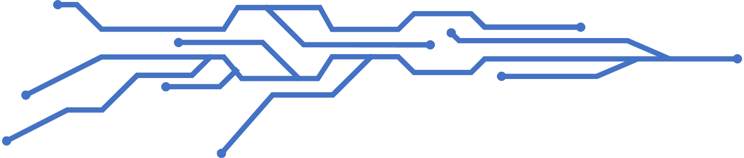
What part of our project is unique
In our project, we have our doctor list along with their speciality, designation & fees, which is the most unique part of our project.
We have online time scheduler which will help to give accurate timing to the patients as well as the doctors.
We have online payment system, where users can pay using visa card, bkash, nagadh.
For this project, our teamwork helped to run the project more efficiently. We helped each other with useful informations and resources.

Slide 6
Challenges that we faced
It took us some time to setting clear goals and objectives in early stage of this project.
It was difficult to set a proper scope of this project given limited resources and time.
It was also a difficult to divide the work among team members due to our expertise and time that would give us most effective ways to build this project.
We faced some technical problem while installing the software dependencies using npm.

Slide 7
What did we do over the course
We followed the agile process to work with the project
First we made a startup plan and then we proceeded step by step to do the work.
As it was a new project, it was challenging for all of us. All the team members divided the work equally and give the update at the right time.
We all learned something new, such as MongoDB, to implement the project. We learned new things while working on the project with any issues arising.
When one member faced a problem during the project, we arranged a meeting on google meet to discuss the problem so that we could solve it.

Slide 8
What we used for the project
Javascript
React js.
Html
Css
MongoDB

Slide 9
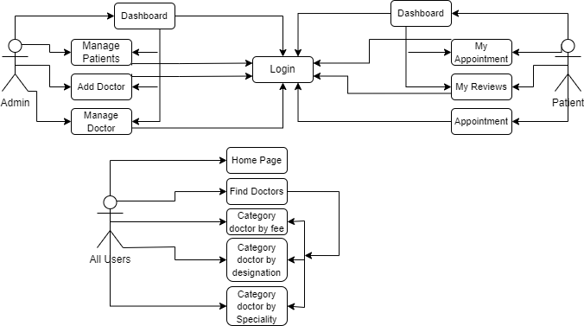
UseCase Diagram

Slide 10
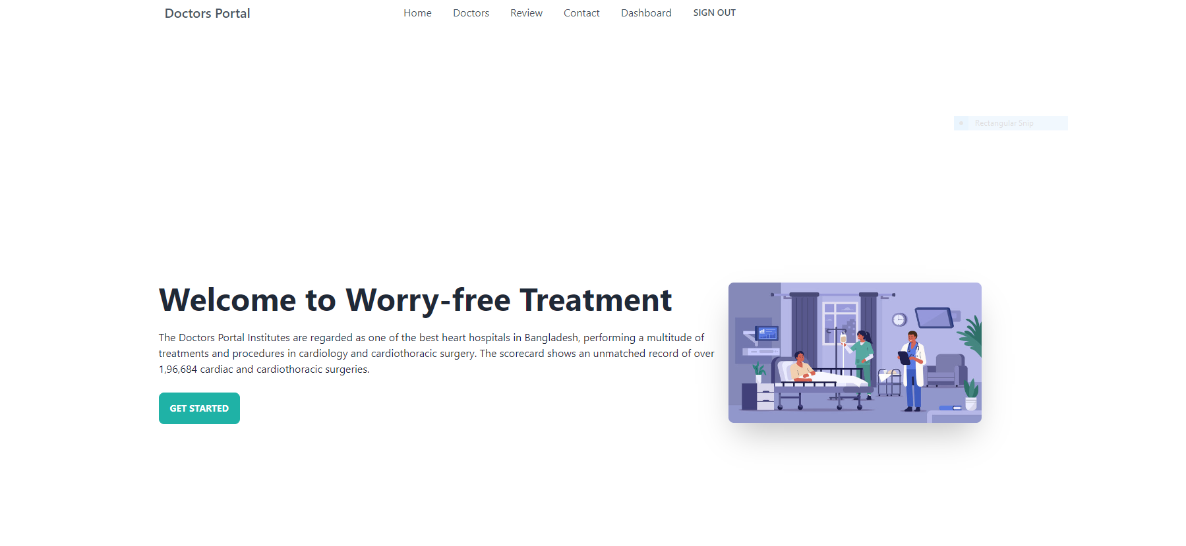
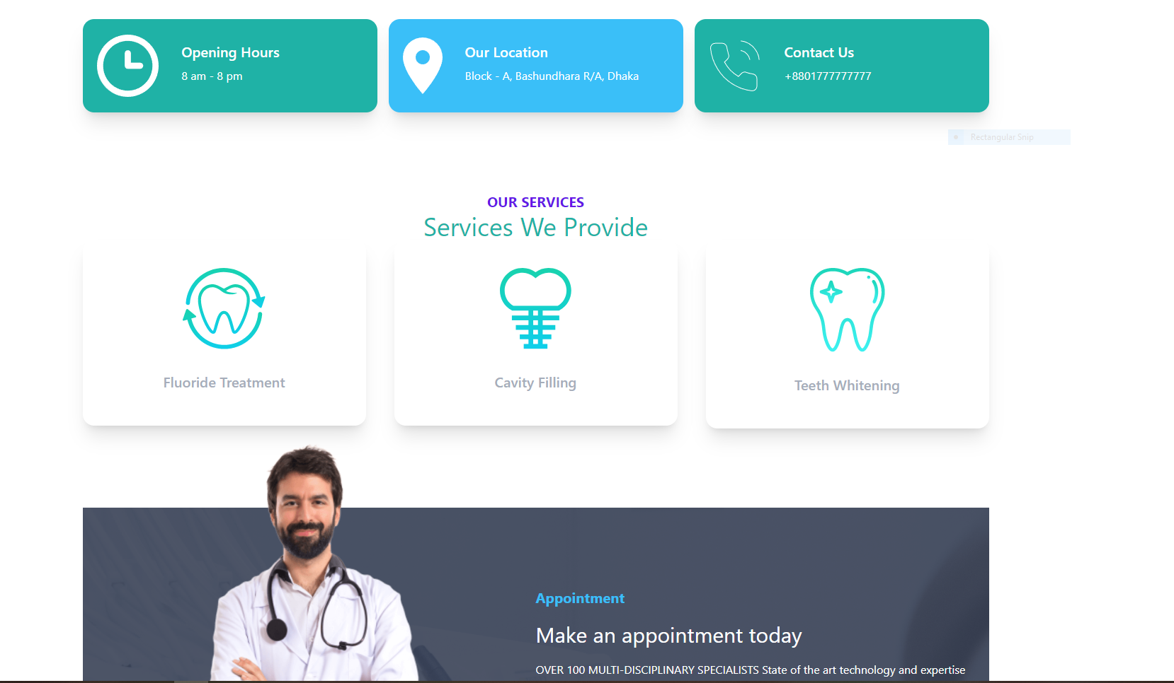
Home Page

Slide 11
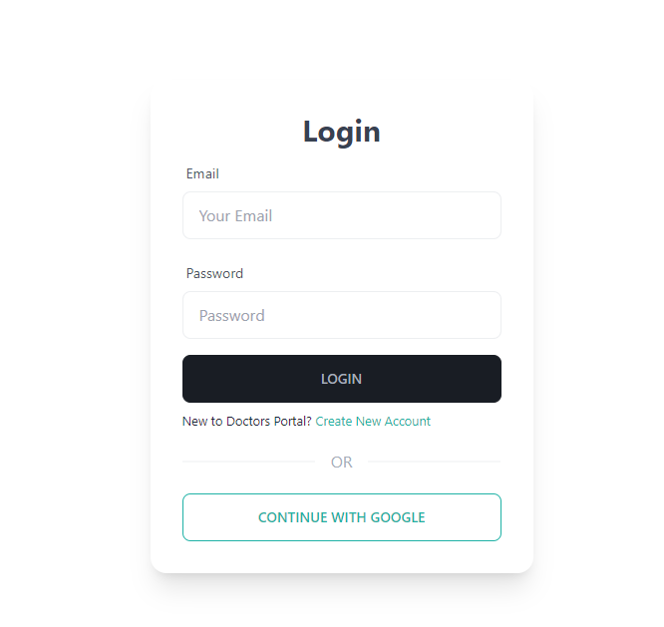
Login Page

Slide 12
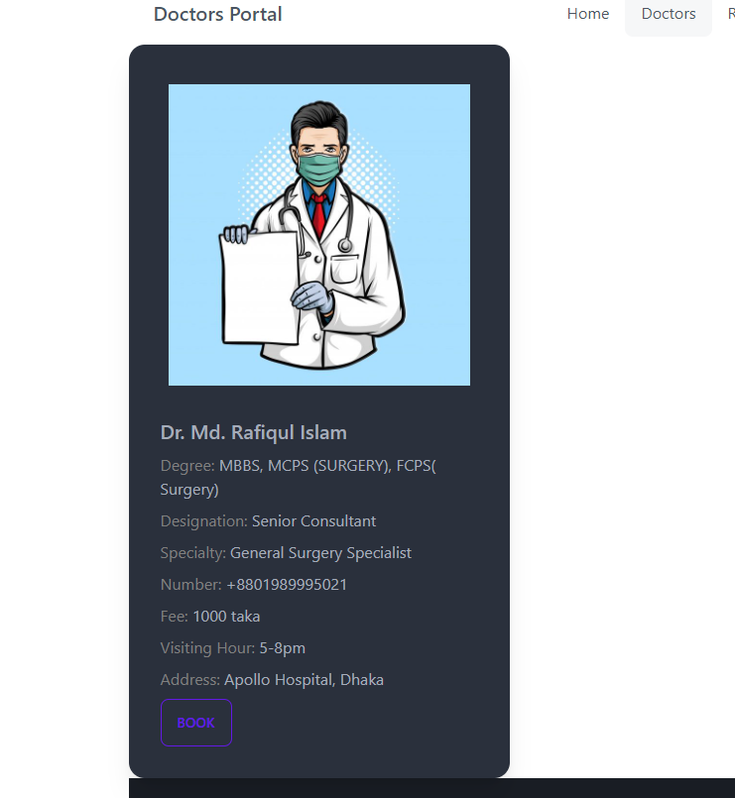
Doctors Page

Slide 13
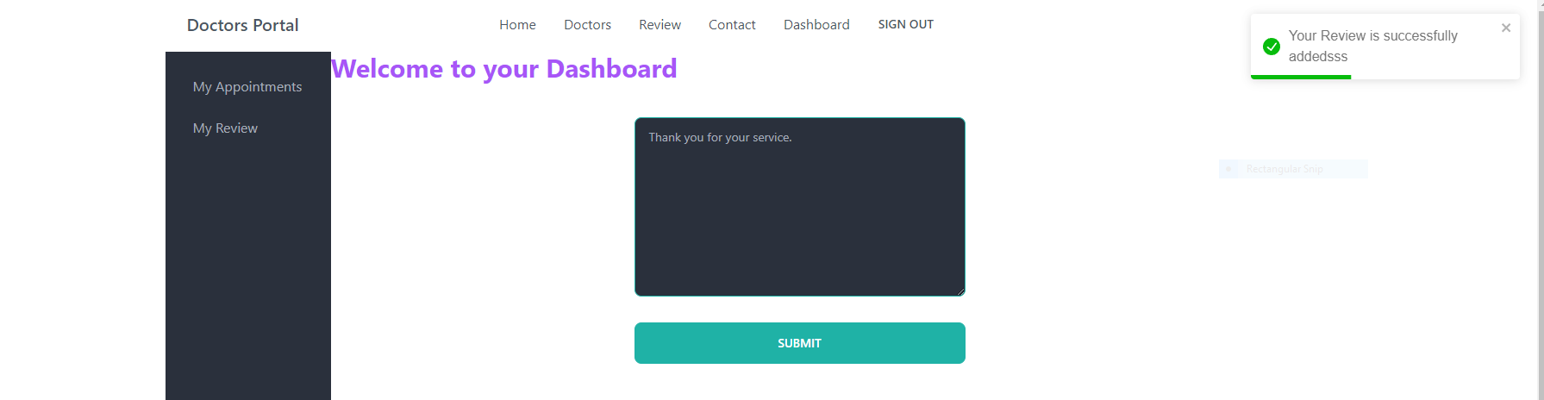
Dashboard Page

Slide 14
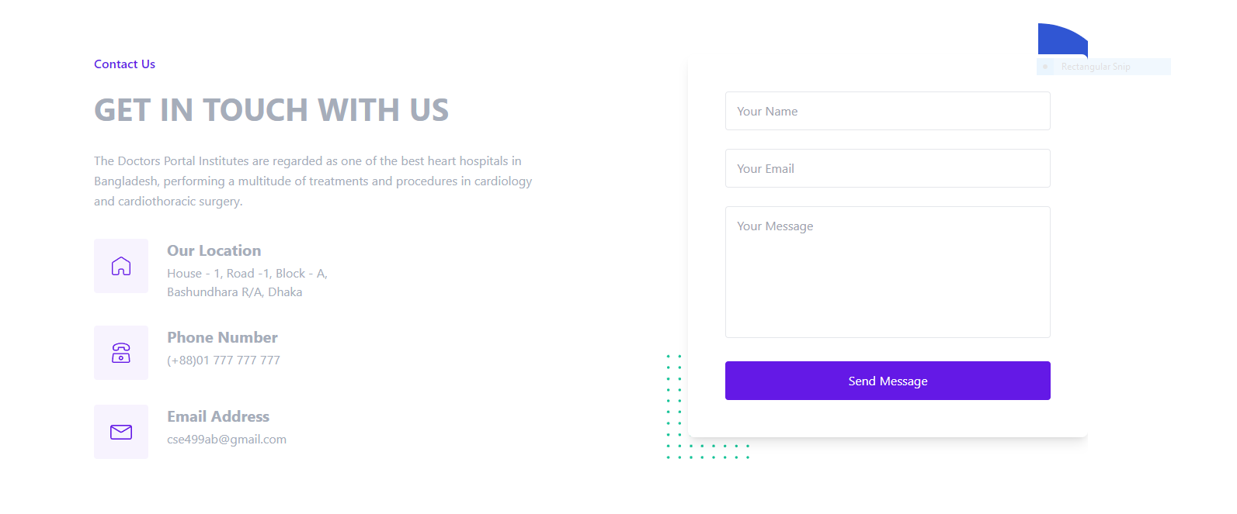
Contact Page

Slide 15
Result analysis
For this project a few parts of the total work were done in CSE499A & the rest of it will be done in CSE499B.
The four of us at first divide the work. We have completed the home page, login page, review page, contact page, and add doctor page. Where user can see the services we are providing, users can see the latest 6 reviews of the people who used this website, can contact us & they also can write about their experiences just like other users.

Slide 16
Future Plans
We have some works which we need to complete in CSE499B. These are:
We have to implement our dashboard where we will have our payment option.
We need to implement our appointment page where we will have the scheduler.
We also have to complete our doctor page.

Slide 17
Thank You

